Slide 1
Researcher orientation & ongoing training series
UGA Postdoctoral Association (PDA)
Graduate Students & Postdocs in Sciences (GSPS)
Office of Postdoctoral Affairs (OPA) / OVPR

Slide 2
UGA ROOTS
Provides information about the practical aspects of research and scholarship at UGA
Appropriate for graduate students, postdocs, early career faculty
Periodic orientation session is strongly recommended for new researchers
Eight individual training sessions after orientation, on two-year rotation
Orientation is a summary of where to find information; your input will guide its evolution

Slide 3
Orientation Outline
The “research office” (OVPR)
Administrative Policies
UGA Human Resources
Graduate School / Graduate Student Policies
Postdoctoral Research Scholar Policies
International Student, Scholar and Immigration Services
UGA Libraries
Core Research Facilities
Research Purchasing
Office of Research Support Services
Ordering Chemicals
Chemical Storage, Tracking, and Waste Disposal

Slide 4
OVPR – What Do We Do?
Our mission is to support research and scholarship in all areas of the university
Grow UGA research through faculty/research staff recruitment
Faculty startup
Research scientist policy, procedures
Office of Postdoctoral Affairs
Help jump-start research programs with seed grants
Enable proposals for external funding of research
Facilitate research partnerships and special initiatives
Ensure access to research facilities, technologies, resources
Ensure the safety and ethical compliance of all UGA research
Promote the value of intellectual property and innovations
Disseminate UGA research successes
Recognize research accomplishments through awards

Slide 5
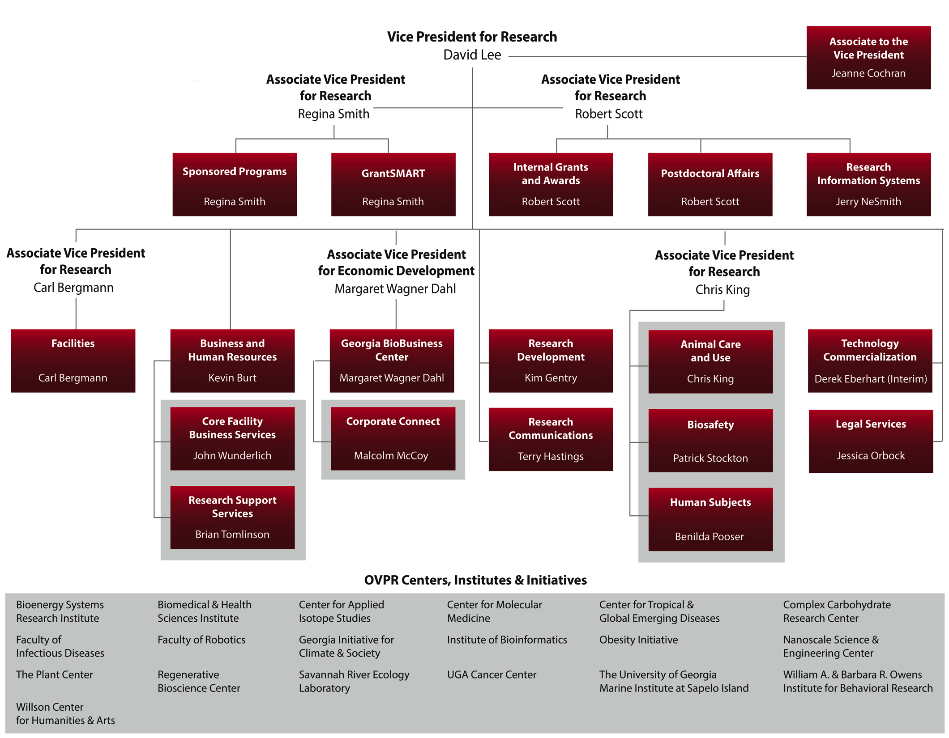

Slide 6
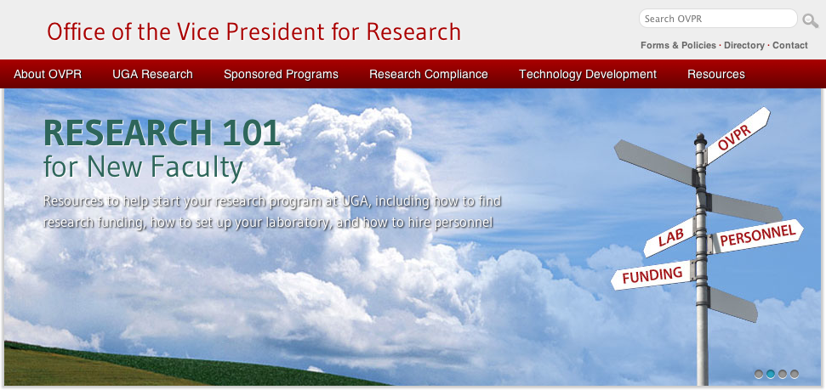
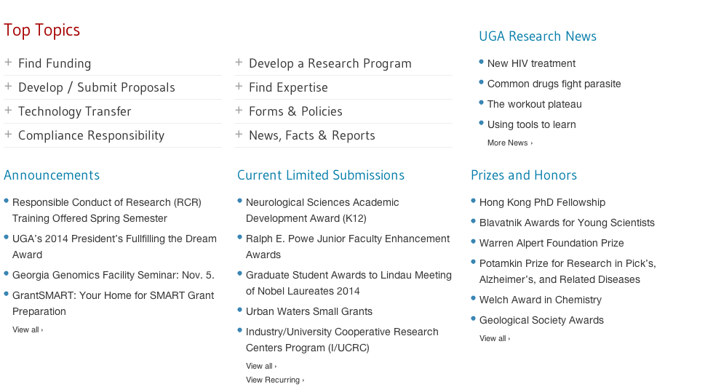

Slide 7
Orientation Outline
The “research office” (OVPR)
Administrative Policies
UGA Human Resources
Graduate School / Graduate Student Policies
Postdoctoral Research Scholar Policies
International Student, Scholar and Immigration Services
UGA Libraries
Core Research Facilities
Research Purchasing
Office of Research Support Services
Ordering Chemicals
Chemical Storage, Tracking, and Waste Disposal

Slide 8
Administrative Policies
Questions about general policy & procedures
Graduate Students – Graduate School (www.grad.uga.edu/contacts_specific.html)
Postdoctoral Research Scholars – OPA (opa@uga.edu)
Faculty – start in department/school, Office of Faculty Affairs (mgorman@uga.edu)
Questions about pay, benefits, taxes, investments
Graduate Students – Graduate School (www.grad.uga.edu/contacts_specific.html)
Postdoctoral Research Scholars – start with Office of Financial & Research Services (kevburt@uga.edu)
Faculty – start in department/school
Many policies/procedures are purview of UGA Human Resources

Slide 9
Intellectual Property Policy
The University encourages the production of creative and scholarly works and the development of new and useful materials, devices, processes and other inventions which may have potential for commercialization. Such work may be protected by laws that establish rights called “Intellectual Property.”
As a condition of employment, all UGA faculty and staff sign an Intellectual Property Agreement
Basically states that all intellectual property is owned by UGA and UGARF.
All faculty and staff agree to disclose in writing to UGARF all intellectual property developed alone or with others during the course of employment.
Revenue sharing potential
www.ovpr.uga.edu/docs/policies/tco/intellectual-property

Slide 10
Technology Commercialization Office (TCO)
TCO serves the UGA community by connecting industry with university expertise and inventions for the public good, promoting economic development and increasing research visibility.
Please contact TCO with questions regarding:
Intellectual property
Material transfer agreements
Non-disclosure agreements
tco@uga.edu

Slide 11
Orientation Outline
The “research office” (OVPR)
Administrative Policies
UGA Human Resources
Graduate School / Graduate Student Policies
Postdoctoral Research Scholar Policies
International Student, Scholar and Immigration Services
UGA Libraries
Core Research Facilities
Research Purchasing
Office of Research Support Services
Ordering Chemicals
Chemical Storage, Tracking, and Waste Disposal

Slide 12
Human Resources / Arrival
You will receive an email with instructions to visit the UGA Onboarding System, where you will complete all required paperwork and view appropriate employment policies
In the Onboarding System, you will see a brief overview of your benefits and retirement choices.
Be sure to meet the deadlines for benefits enrollment!

Slide 13
Personnel Activity Reports (ePAR)
The University is reimbursed by the Federal Government for costs associated with federal contracts and grants. As such, UGA is subject to Federal guidelines, specifically OMB Circular A-21: Cost Principles for Educational Institutions
A-21 contains requirements for documenting salaries and wages charged directly to an award or through F&A
The employee’s salary must be allocated through an official payroll system that ties with the financial records of the institution
…

Slide 14
Personnel Activity Reports (ePAR)
The payroll distribution must reasonably reflect the activity for which the employee is compensated
The main objective of A-21 is verification that compensation charged is appropriate to the activity performed
Every employee fills out ePAR monthly to verify this
PAR’s are used to confirm that the distribution of activity represents a reasonable estimate of the work performed by the employee during the period
Each PAR must be reviewed for accuracy and approved by the employee or by someone having first-hand knowledge of the work performed

Slide 15
Human Resources / Insurance
Graduate students enroll in separate group insurance
Employees are eligible to enroll in all “health & welfare” benefits. If you do not enroll during your first 31 days of employment, you must wait for the next open enrollment period, typically each fall
Health, dental, life, accidental death & dismemberment, long term disability, short term disability, cancer, critical illness, and accident insurance products, are all available
www.hr.uga.edu/fmec_intro.html

Slide 16
Human Resources / Retirement
Graduate students have no retirement benefits
Your retirement plan choice must be made during your first 60 days of employment and is irrevocable during your UGA employment
There are two basic choices:
Teachers Retirement System (TRS) is a defined benefit plan with 10-year vesting
Optional Retirement Plan (ORP) is a defined contribution plan with immediate vesting and is portable
www.hr.uga.edu/fmec_intro.html

Slide 17
Human Resources / Contacts
Employees may contact HR at any time to schedule a 360 Personal Financial Consultation or to ask questions about their benefits
360 PFC: contact Cindy Walker to schedule an appointment cewalker@uga.edu or 706-542-7359
General benefits questions: benefits@uga.edu or 706-542-2222
Be sure to contact HR prior to leaving UGA and discuss your options regarding your benefits and retirement plan: benefits@uga.edu or 706-542-2222

Slide 18
Orientation Outline
The “research office” (OVPR)
Administrative Policies
UGA Human Resources
Graduate School / Graduate Student Policies
Postdoctoral Research Scholar Policies
International Student, Scholar and Immigration Services
UGA Libraries
Core Research Facilities
Research Purchasing
Office of Research Support Services
Ordering Chemicals
Chemical Storage, Tracking, and Waste Disposal

Slide 19
Graduate School
The UGA Graduate School sets campus-wide policy and procedures for graduate education
Each graduate program may choose different ways to satisfy Graduate School policies
When you have a question about graduate student policies, first talk with your program’s coordinator (graduate program administrator, degree program assistant, several titles), who can contact the Graduate School if necessary
Graduate students are solely responsible for satisfying all requirements and meeting all deadlines
grad.uga.edu

Slide 20
Graduate Assistantship Pay Rates
Pay rates are set by college, school, or program
Pay rates are based on % of assigned work time per week (between 33% and 50%)
Differential rate between master’s and doctoral level students
Differential rate between academic and fiscal year employment

Slide 21
Graduate Student Health Insurance
Mandatory plan for international students, students receiving graduate assistantships, qualified fellowships, and qualified training grants
Students who are mandated to have coverage under the mandatory student health insurance plan may request to opt out of the mandatory student health insurance plan if they can demonstrate they have a health insurance plan that meets the minimum requirements.
General student health insurance information http://www.hr.uga.edu/benefits/stuins/stuins.html
Contact Joanna Manzi, gshiplan@uga.edu, for specific information

Slide 22
Graduate Student Listserv
Official university communication with all graduate students is the Graduate Student listserv
Policies
Deadlines
Special events
Fellowship, scholarship, and other award announcements
All admitted graduate students are added to listserv
Information also posted on Graduate School website, Facebook page, and Twitter feed

Slide 23
Graduate Faculty
To be major professor, faculty must be members of the Graduate Faculty
Three principal intellectual criteria for any faculty member seeking membership in the Graduate Faculty:
Doctorate or highest earned terminal degree from an accredited institution in the faculty member’s discipline
Proficiency in conducting scholarly research
Proficiency in supervising scholarly research
http://grad.uga.edu/faculty/procedures.html

Slide 24
Orientation Outline
The “research office” (OVPR)
Administrative Policies
UGA Human Resources
Graduate School / Graduate Student Policies
Postdoctoral Research Scholar Policies
International Student, Scholar and Immigration Services
UGA Libraries
Core Research Facilities
Research Purchasing
Office of Research Support Services
Ordering Chemicals
Chemical Storage, Tracking, and Waste Disposal

Slide 25
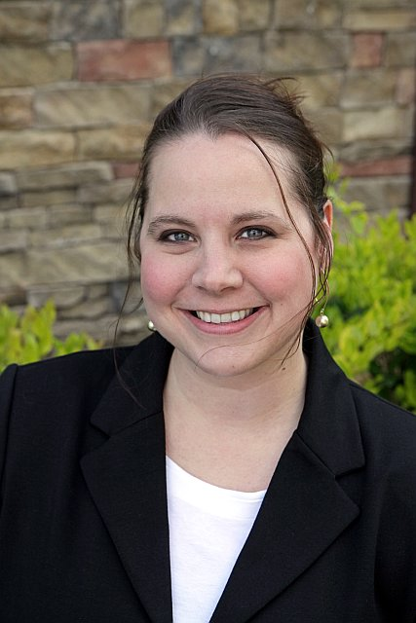
Postdoctoral Research Scholar Policies
Term of Appointment
Maximum term of 5 years
At end of 5 years, must be separated or
moved into a new position with 90 days notice
Potential established positions at UGA
Research Professional IV (or III)
Asst Research Scientist (non-tenure track faculty)
Compensation
Postdoctoral research scholars should be compensated at a level appropriate to their advanced education and training
The university strongly suggests a minimum salary of $35,000 in FY2014 for Postdoctoral Research Associates
In some disciplines, external funding agencies provide salary guidance. For example, in the biological sciences, NIH publishes guidelines based on years of training experience
www.ovpr.uga.edu/docs/policies/opa/postdoctoral-research-appointments
Jessica Hawks

Slide 26
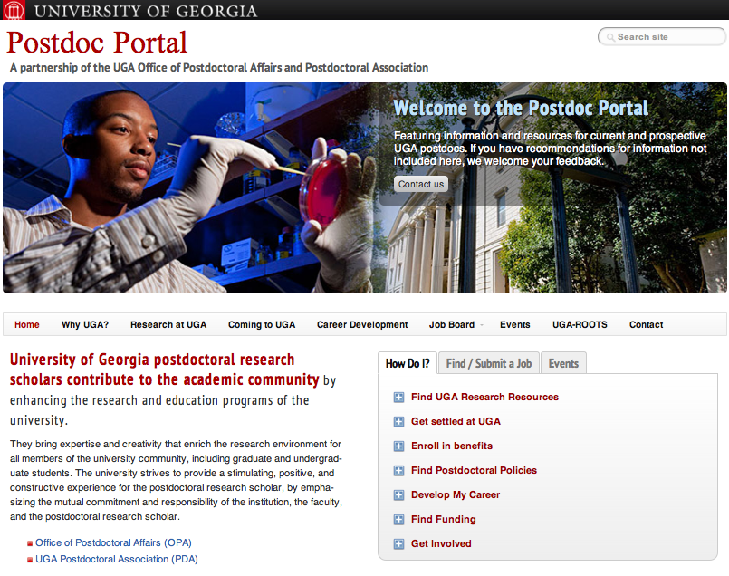

Slide 27
Orientation Outline
The “research office” (OVPR)
Administrative Policies
UGA Human Resources
Graduate School / Graduate Student Policies
Postdoctoral Research Scholar Policies
International Student, Scholar and Immigration Services
UGA Libraries
Core Research Facilities
Research Purchasing
Office of Research Support Services
Ordering Chemicals
Chemical Storage, Tracking, and Waste Disposal

Slide 28
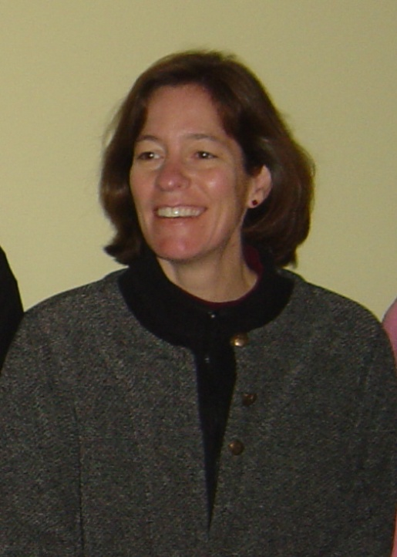
International Student, Scholar & Immigration Services (ISSIS)
Contact Information:
Office of International Education
1324 South Lumpkin Street
Athens, GA 30602
706-542-2900
issis@uga.edu
http://www.issis.uga.edu
Robin Catmur
Director, ISSIS, Office of International Education

Slide 29
ISSIS: Visa Categories for Postdocs
J-1 categories
Student
Student Intern
Professor
Specialist
Research Scholar
Short-term Scholar
H-1B temporary worker
E-3 (Australian nationals); TN (Canadian or Mexican nationals)
Permanent residency ONLY if you are “promoted” to a permanent research or teaching position …

Slide 30
ISSIS: J-1 / H-1B Advisors Contact
We will provide you with accurate and timely advice and information pertaining to your visa category.
Sylvia Schell - sylvias@uga.edu
Sandy Haagen – sphaagen@uga.edu
Link to the caseload distribution
http://www.issis.uga.edu/images/docs/for_departments/ississcholarcaseloaddivision.pdf
issis@uga.edu

Slide 31
ISSIS: Orientation & Support
Immigration check-in and orientation – mandatory – and helpful!
Spouse and dependent support: International Family Association (Linnea Fisher: lfisher@uga.edu)
Scholar programming and trips: Sylvia Schell: sylvias@uga.edu
Driver’s License information: http://www.issis.uga.edu/for-scholars/arriving-at-uga/social-security-card.html
Social Security Card information: http://www.issis.uga.edu/for-scholars/arriving-at-uga/drivers-license.html

Slide 32
Orientation Outline
The “research office” (OVPR)
Administrative Policies
UGA Human Resources
Graduate School / Graduate Student Policies
Postdoctoral Research Scholar Policies
International Student, Scholar and Immigration Services
UGA Libraries
Core Research Facilities
Research Purchasing
Office of Research Support Services
Ordering Chemicals
Chemical Storage, Tracking, and Waste Disposal

Slide 33
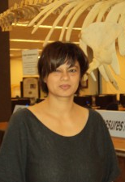
UGA Libraries
Contact Information:
Science Collections & Scholarly Communication Department
706-542-6643
mariann@uga.edu
www.libs.uga.edu/science/scicolldev.html
Mariann Burright
Head, Science Collections & Scholarly Communication

Slide 34
Science Collections & Scholarly Communication Department
We are located in Room 207 Science Library
We are responsible for the science and engineering collections on the UGA campus
purchasing and maintaining the book, journal subscriptions (print and online), and databases that allow you to search the literature in your fields
We offer assistance in answering questions about scholarly publishing, open access, and copyright

Slide 35
Collections Services
Overview of our collections in the sciences and engineering
11,606+ online journal subscriptions in agriculture, life & health sciences, biochemistry, engineering, and environmental sciences
4,242 titles are funded by UGA
7,364 titles are funded through the state system called GALILEO
Many research databases such as SciFinder Scholar, Ei Engineering Village, Web of Science, and others.
We’re moving to mostly online access to research journals
We’re also buying more online books, but the vast majority are physical books on the shelves of the Science Library, with some in the Vet Med Reading room

Slide 36
Publishing Services
Find funding and collaborators in your area
Comply with federal publication and data management mandates (NIH and NSF, so far!)
Publish Open Access: UGA authors receive a 15% discount on author processing fees to publish open access with BioMedCentral, ChemCentral, and SpringerOpen.
Email mariann@uga.edu for details.
Evaluate journal rankings for submission
Keep copyright in your publications
Promote discoverability of your work on the internet, archive or publish it in the UGA institutional repository Athenaeum@UGA

Slide 37
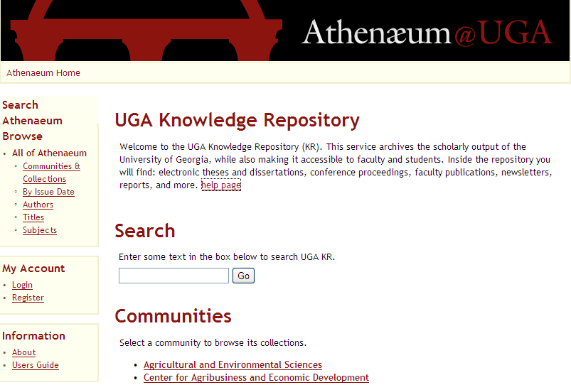
UGA’s Institutional Repository
athenaeum.libs.uga.edu/

Slide 38
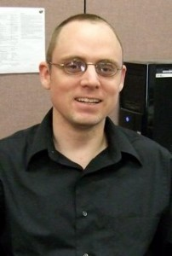
Reference Department
Research help
Tracking down citations and information
Troubleshooting access issues to databases
Using resources efficiently and effectively
Helping find grant funding/career opportunities
Citation Management
Endnote training and troubleshooting
Teaching research skills
Can provide library skills training to your classes or lab sections upon request
Ian Thomas
Research and Instruction Librarian, Science Library 706-542-0703 ithomas@uga.edu

Slide 39
Orientation Outline
The “research office” (OVPR)
Administrative Policies
UGA Human Resources
Graduate School / Graduate Student Policies
Postdoctoral Research Scholar Policies
International Student, Scholar and Immigration Services
UGA Libraries
Core Research Facilities
Research Purchasing
Office of Research Support Services
Ordering Chemicals
Chemical Storage, Tracking, and Waste Disposal

Slide 40
Core Research Facilities
Some research services or products utilize expertise or instruments that are not efficiently replicated in each research group
Shared-use core research facilities can be found across campus
UGA has no current organizational unit to manage core facilities; they report to many different units (offices, colleges, schools, departments, centers, institutes)
OVPR has attempted to gather links to core facilities (www.ovpr.uga.edu/resources/core-facilities) but this list is not comprehensive

Slide 41
Orientation Outline
The “research office” (OVPR)
Administrative Policies
UGA Human Resources
Graduate School / Graduate Student Policies
Postdoctoral Research Scholar Policies
International Student, Scholar and Immigration Services
UGA Libraries
Core Research Facilities
Research Purchasing
Office of Research Support Services
Ordering Chemicals
Chemical Storage, Tracking, and Waste Disposal

Slide 42
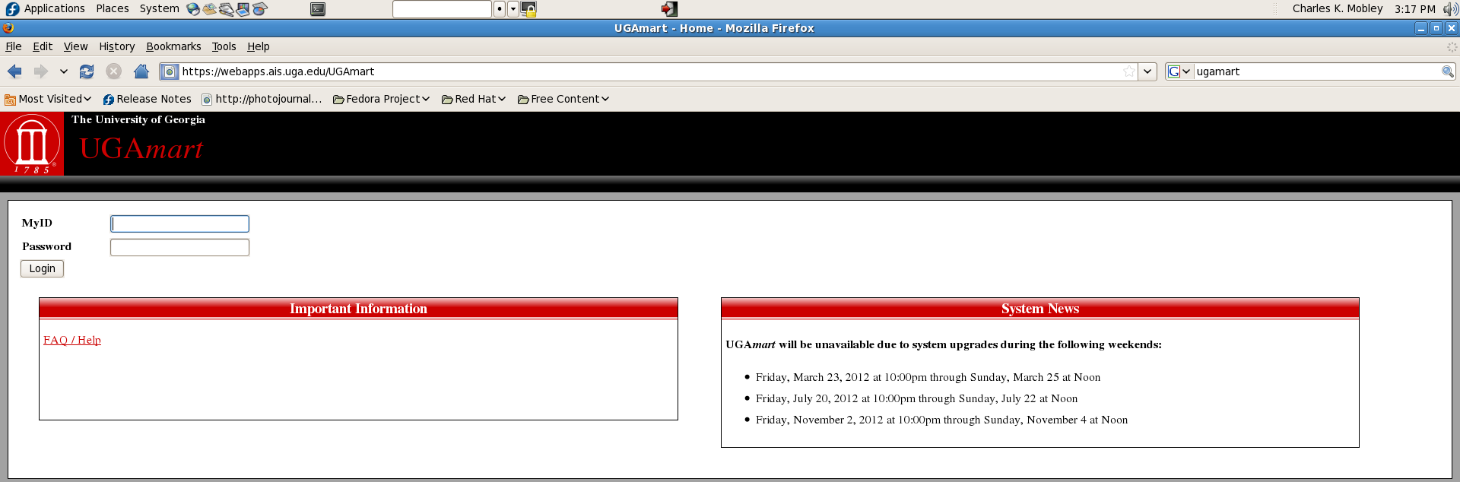
Research Purchasing / UGAMart
UGAMart is the online purchasing web app for purchasing everything except chemicals
https://webapps.ais.uga.edu/UGAmart

Slide 43
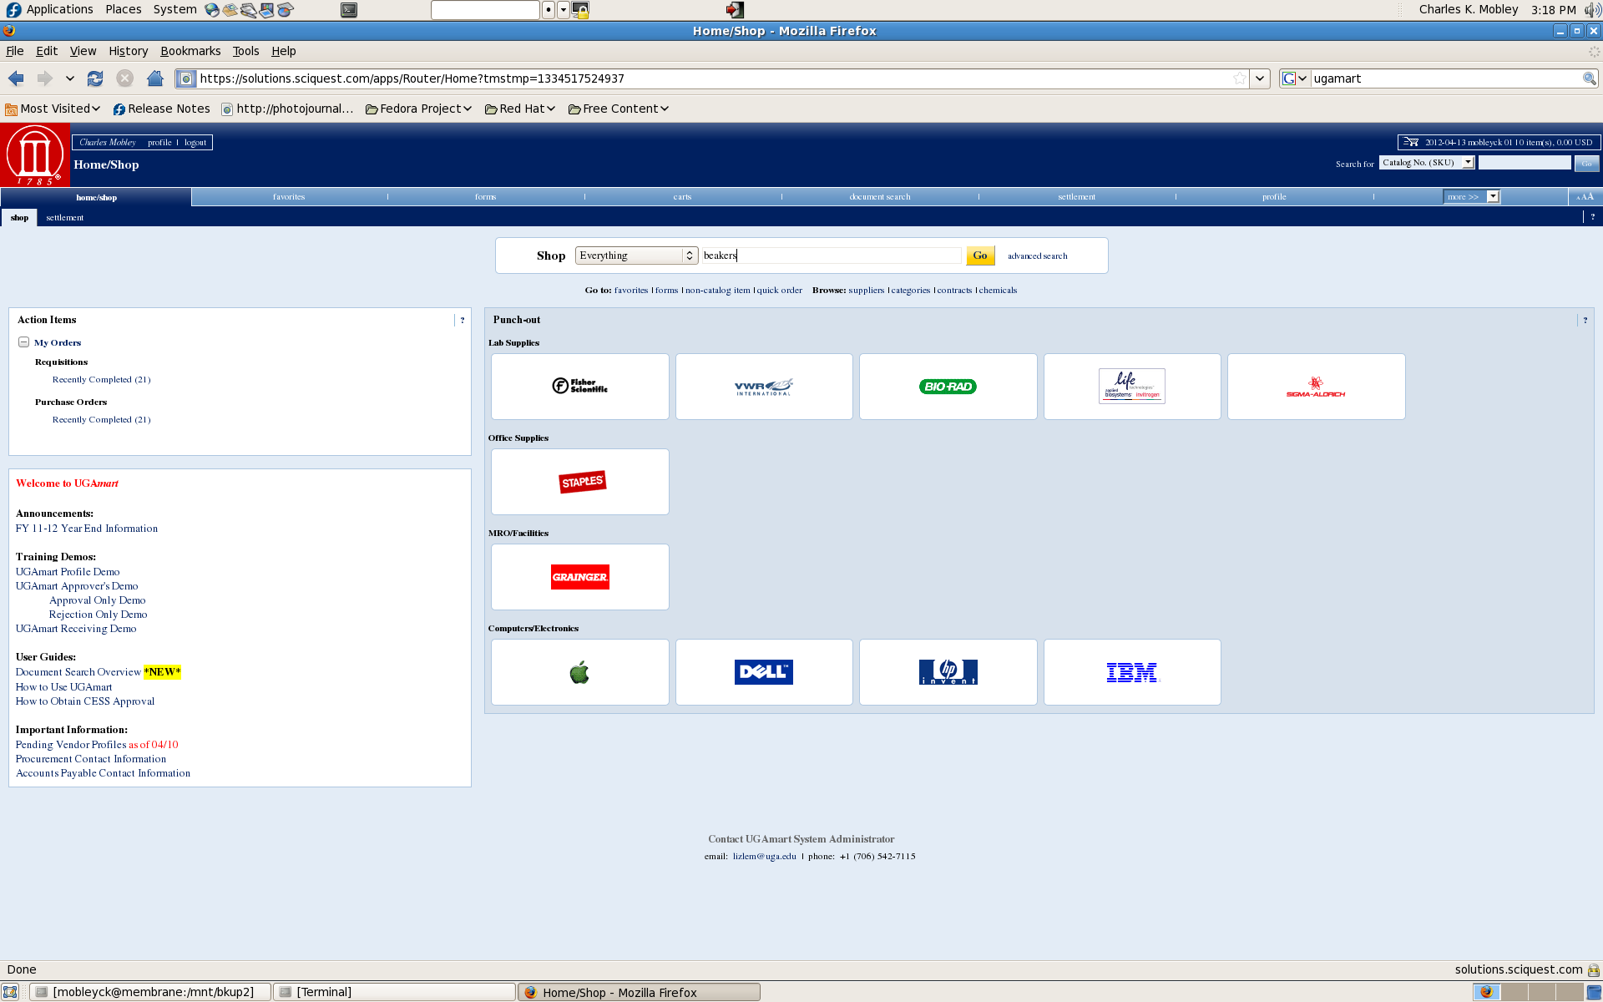
UGAMart vs. Punchout Searches

Slide 44
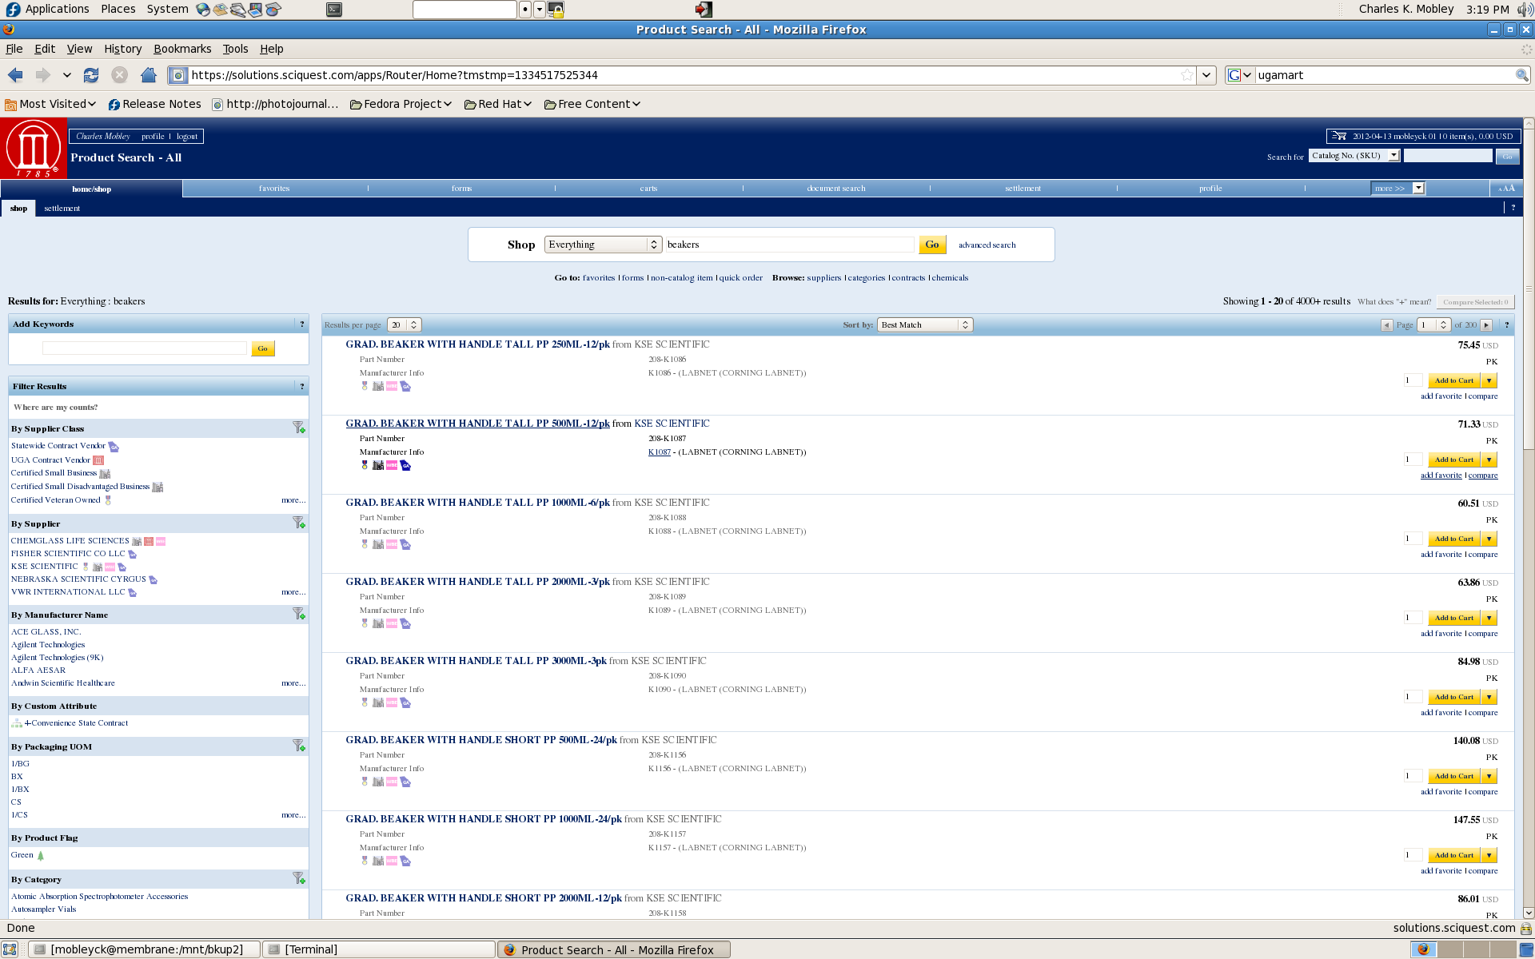
UGAMart Search Results

Slide 45
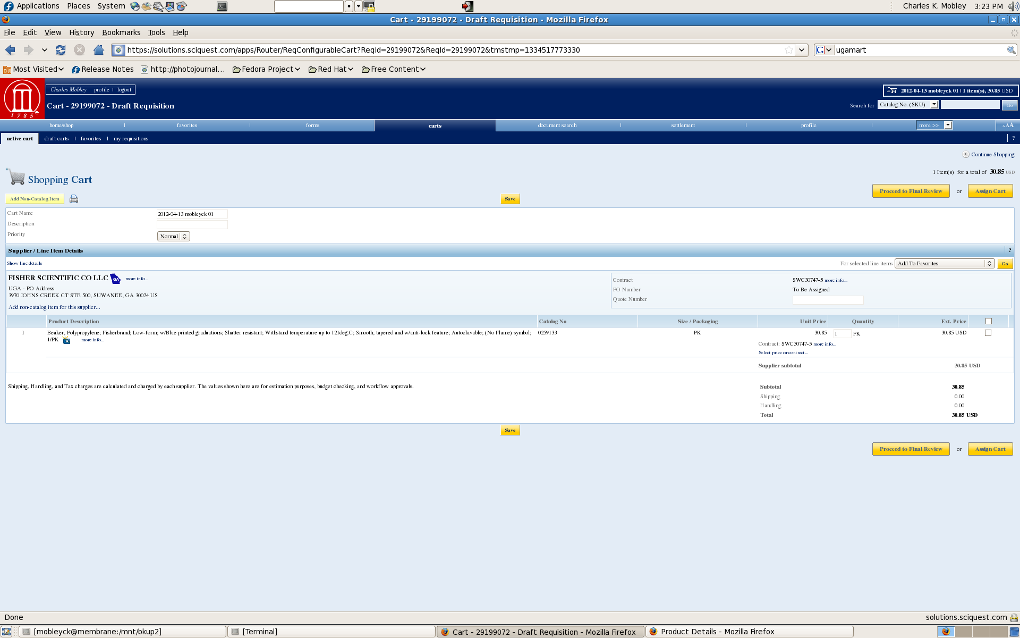
UGAMart Assignment of Cart

Slide 46
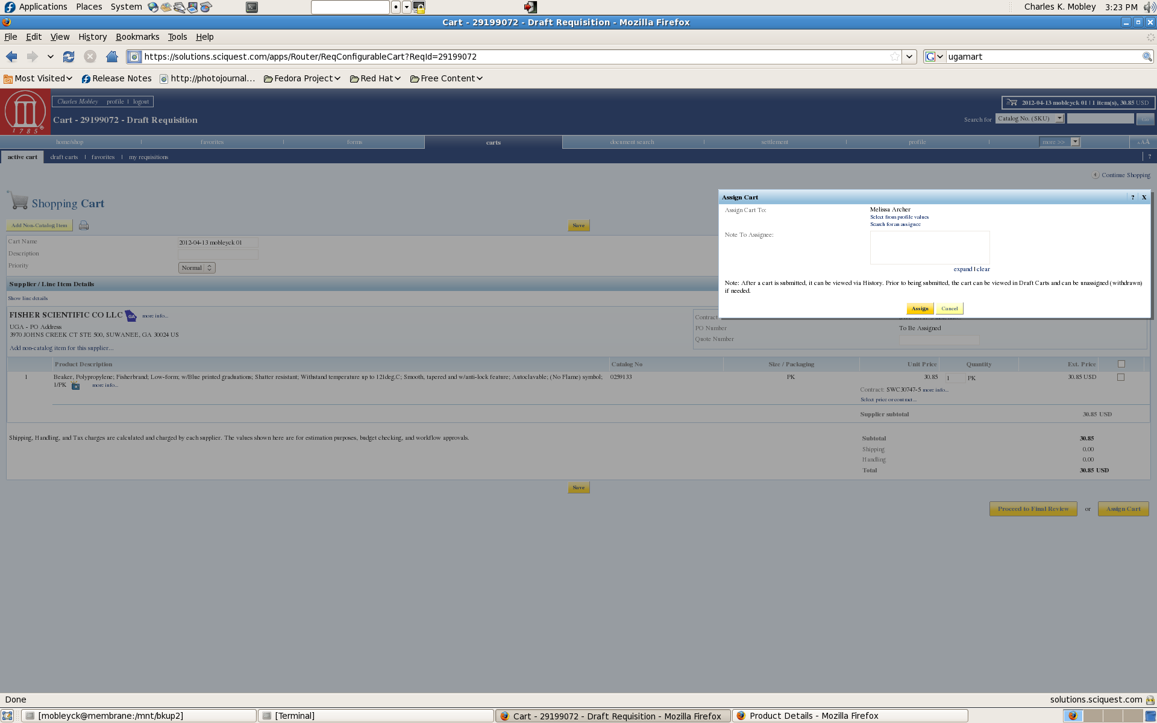
UGAMart Assignment of Cart

Slide 47
Orientation Outline
The “research office” (OVPR)
Administrative Policies
UGA Human Resources
Graduate School / Graduate Student Policies
Postdoctoral Research Scholar Policies
International Student, Scholar and Immigration Services
UGA Libraries
Core Research Facilities
Research Purchasing
Office of Research Support Services
Ordering Chemicals
Chemical Storage, Tracking, and Waste Disposal

Slide 48
Office of Research Support Services
ORSS is a unit of the Office of Business & Human Resources in OVPR
ORSS offers services that support the UGA research enterprise
ORSS includes
Central Research Stores (CRS)
Campus Scientific Stores (CSS)
Instrument Design & Fabrication Shop
Glassblowing Shop

Slide 49
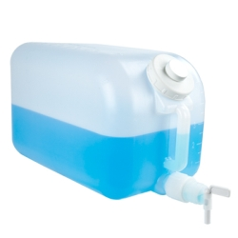
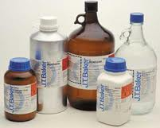
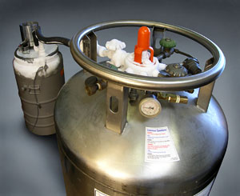
ORSS / Central Research Stores
Central Research Stores – CRS Warehouse
Lab plastics and glass supplies
190 Proof Alcohol pour ups by 5 gallon quantities
Same day liquid nitrogen tank rental & delivery
Campus chemical distributor
Ordering: 542-2411 (Robbin); online crs.uga.edu (Mozilla browser preferred); FAX 542-5976; email crs@uga.edu

Slide 50
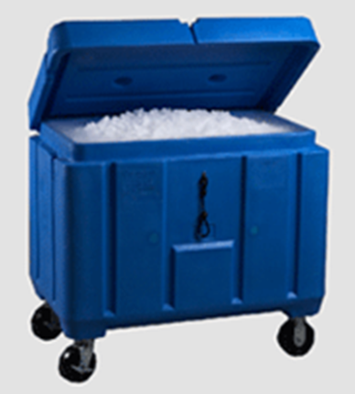
ORSS / Campus Scientific Stores
Convenience Store – Ground Floor Chemistry Building
Extensive freezer program
Compressed gas cylinders
Dry Ice by the pound
Liquid nitrogen pour ups

Slide 51
ORSS / Instrument Shop
ishop.uga.edu
Custom fabrication of scientific, deep ocean, agricultural, and industrial equipment
Repair of lab instruments – CO₂ incubators, centrifuges, and food grade equipment
CAD & CAM design – Custom CAD drawing and editing to meet your concept

Slide 52
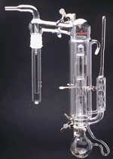
ORSS / Glassblowing Shop
glass.uga.edu
Repairs & modifications to existing items
Micro-distillation
Mercury diffusion pumps
Klett flasks
Filter crucibles
Large diameter columns
Custom fabrication
Located in Chemistry Building

Slide 53
Orientation Outline
The “research office” (OVPR)
Administrative Policies
UGA Human Resources
Graduate School / Graduate Student Policies
Postdoctoral Research Scholar Policies
International Student, Scholar and Immigration Services
UGA Libraries
Core Research Facilities
Research Purchasing
Office of Research Support Services
Ordering Chemicals
Chemical Storage, Tracking, and Waste Disposal

Slide 54
Ordering Chemicals: What is a Chemical?
University of Georgia Chemical and Laboratory Safety Manual (www.esd.uga.edu/chem/safetymanual.htm), Section 2 Part I A
The director of CRS is designated as the sole agent for submitting purchase requests for chemicals to the University procurement office, receiving, and distributing all chemicals to on-campus research and science laboratories and academic units of UGA
A substance is a chemical if it has a NFPA Fire Diamond Hazard rating 2 or greater
A substance is a chemical if it requires DOT Hazardous Materials designation for shipping
A substance is a chemical when MSDS requires:
Item not be placed in the landfill
Licensed disposal to a private contractor
Item to not be poured down drains
Avoid release to the environment

Slide 55
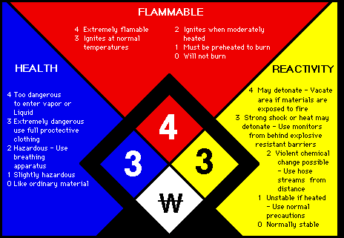
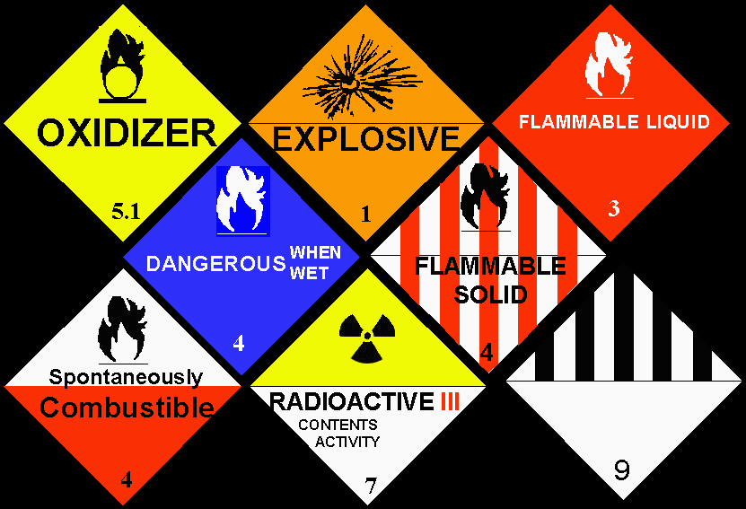
Ordering Chemicals: What is a Chemical?

Slide 56
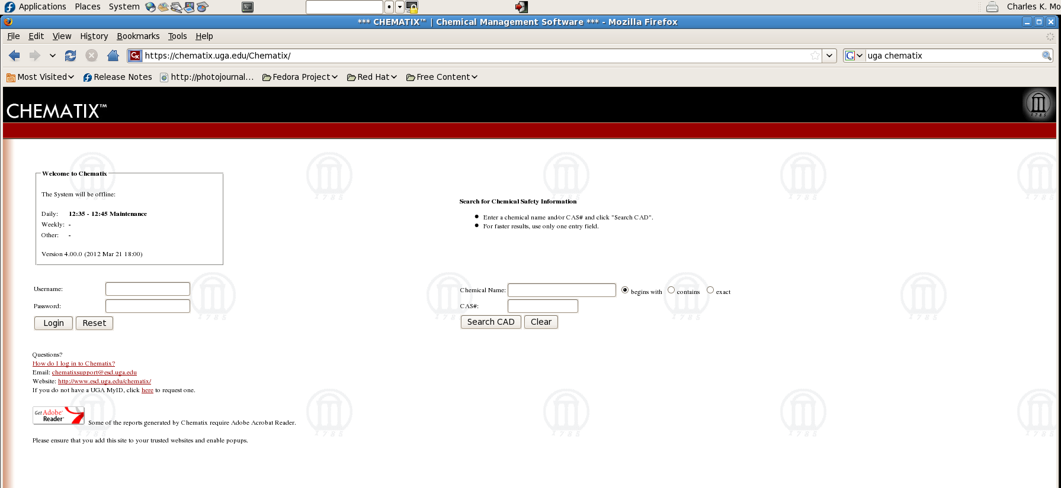
Ordering Chemicals: What is a Chemical?
UGA uses Chematix for chemical and laboratory safety management (https://chematix.uga.edu/Chematix/)
Many chemicals will be identified in Chematix

Slide 57
Ordering Chemicals
Chemicals must be ordered through CRS (crs.uga.edu)

Slide 58
Orientation Outline
The “research office” (OVPR)
Administrative Policies
UGA Human Resources
Graduate School / Graduate Student Policies
Postdoctoral Research Scholar Policies
International Student, Scholar and Immigration Services
UGA Libraries
Core Research Facilities
Research Purchasing
Office of Research Support Services
Ordering Chemicals
Chemical Storage, Tracking, and Waste Disposal

Slide 59
Chemical Storage, Tracking, & Waste Disposal
The UGA Environmental Safety Division (ESD, esd.uga.edu) is responsible for the Chemical and Laboratory Safety Program
The Chemical and Laboratory Safety Program provides guidance to UGA faculty, staff and students on the safe use of chemical agents
The program focus is chemical safety, health, environmental protection, and compliance based on current government regulations, guidelines and best management practices
For assistance, contact Greg Bell, belbo@uga.edu, 706-542-0105

Slide 60
Chemical Storage, Tracking, & Waste Disposal
Services provided by the Chemical and Laboratory Safety Program
Lab Safety and Right to Know training
Proper chemical labeling
Lab openings, closings, and transfers
Chemical inventory and MSDS
Personal protective equipment (PPE)
Chemical spill and emergency information
Lab safety inspections

Slide 61
Web Resources
Office of the Vice President for Research
http://www.ovpr.uga.edu/
Research 101
http://www.ovpr.uga.edu/resources/research-101
Faculty Research Expertise Database (FRED)
http://fred.ovpr.uga.edu/
Postdoc Portal
http://postdocs.uga.edu/
Graduate Students and Postdocs in Science
http://www.gsps.uga.edu/
Graduate School
http://www.grad.uga.edu/

