Slide 1
Coffee and Conversation: Research Mentoring
Brandon Rotavera
Department of Chemistry | College of Engineering
October 22, 2024

Slide 2
Types of Mentoring
Academic
Professional Development
Other Forms

Slide 3
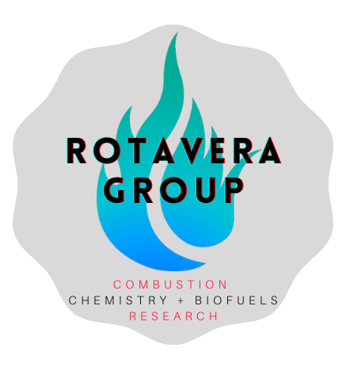
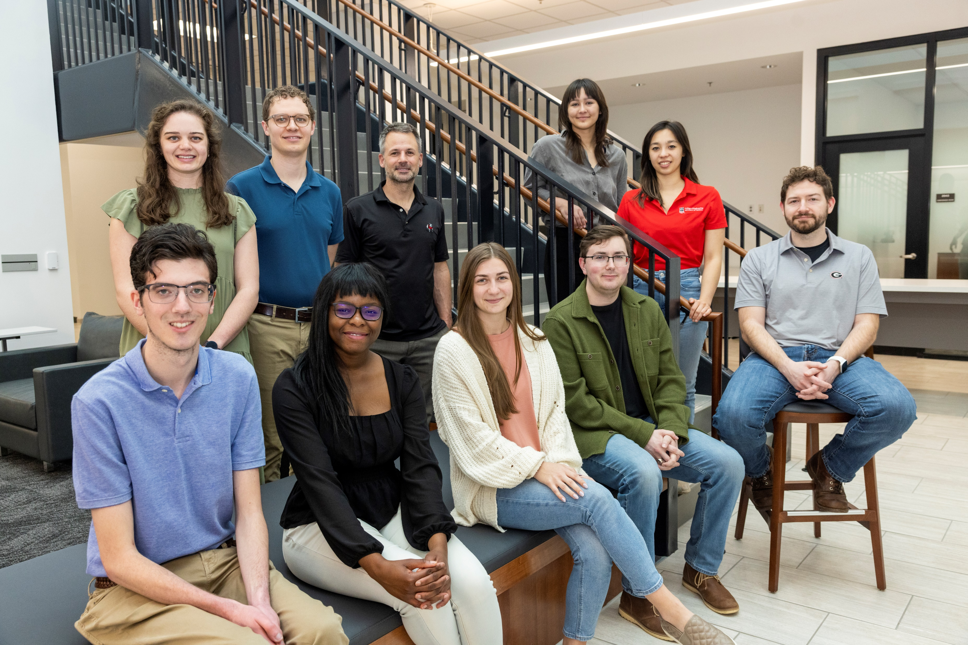
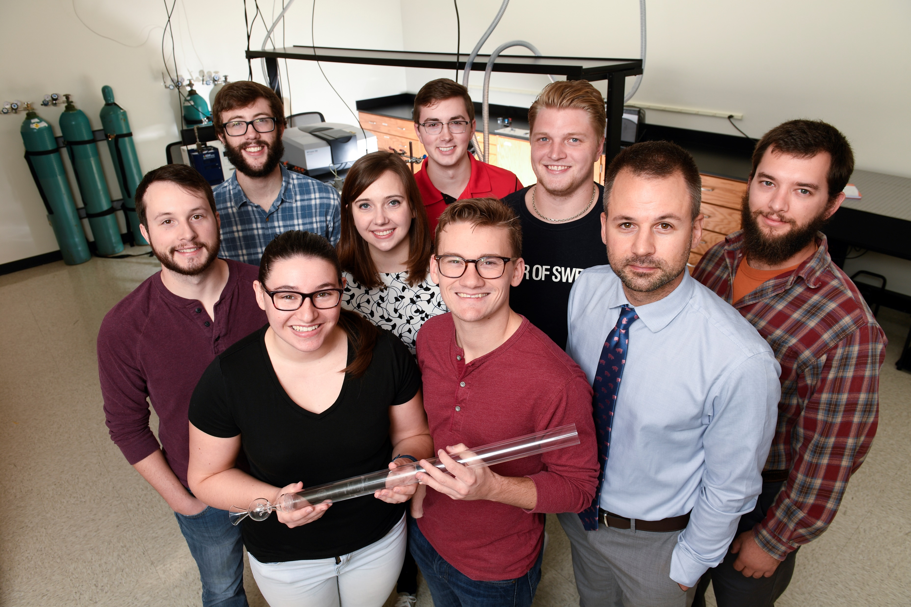

Slide 4
Academic Support
Help navigate departmental program requirements.
Institute deadlines for programmatic milestones.
Help cultivate effective time management skills for meeting responsibilities.
Advise on coursework selection.
Help identify and pursue research interests.
Show how to employ ethical research practices.
Meet regularly and ensure progress on degree program requirements.
Review results/writing and provide feedback in a timely and constructive manner.

Slide 5
Professional Development Support
Discuss practices and procedures of professional activities such as conference attendance, grant writing, applying for fellowships, and academic publishing.
Keep apprised of professional development opportunities (grants, fellowships, publication opportunities, etc.).
Teach about / model networking practices in the field.
Involve in collaborations to provide leadership experience.
Help identify and pursue my career goals (whether inside or outside of academia).

Slide 6
Other Forms of Support
Ensure student/mentee feels recognized and supported.
Aid in developing self-image/value as a researcher and teacher.
Advocate for student/mentee in the department and in other research and disciplinary spaces.
Define a culture in which student/mentee feels confident voicing ideas.
Listen to needs and take ideas seriously.

Slide 7
Q&A

